Slide 1
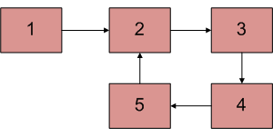
Find First Node In A loop
Step-1 Check Loop Exist or not
Step 2-if not exist then return null
Step-3 if exist then ,initialize a slow pointer to head ,fast ba at its position
Step -4 Move both pointer alow and fast one node at a time
Step 5- meeting point of both pointer is the start of the loop (i.e.first node in a loop)
Step 6:let’s enjoy

Slide 2
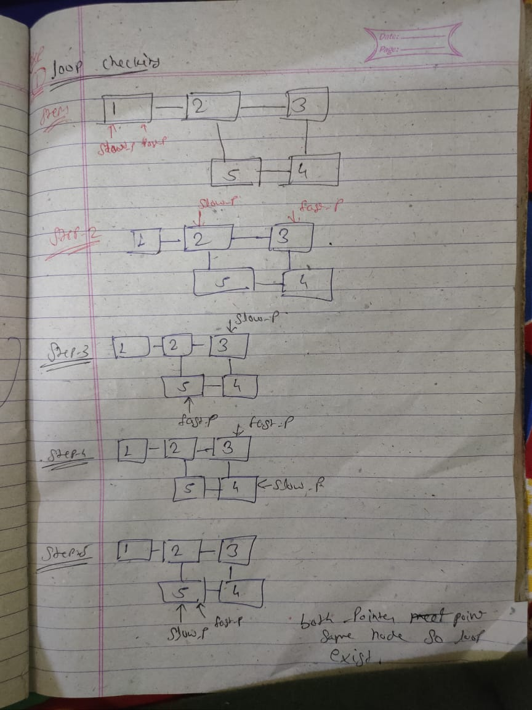
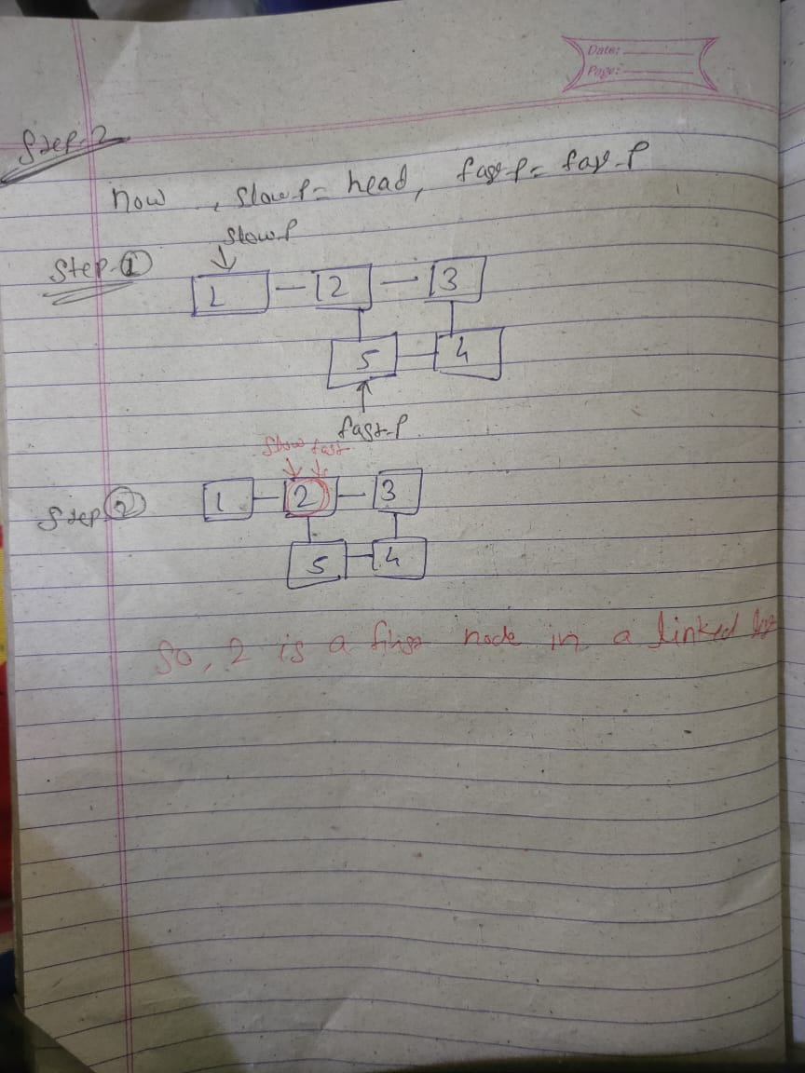

Slide 3
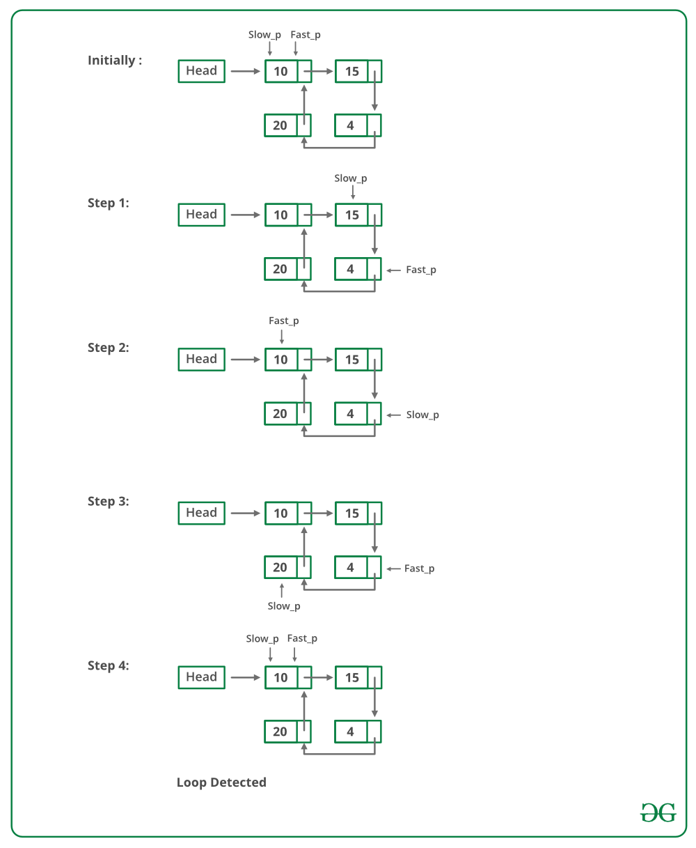
Check Loop Exist or not:
Floy’d Cycle-Finding Alogrithm-Fatsest Method
Step -1 : Traverse linked list using Two Pointers
Step-2: Move Fast pointer by two node at a time &
slow pointer by one pointer at a time
Step 3: if they meet at the same node then loop exist
otherwise loop not exist

